Slide 1
How to Place a Bid Unison Marketplace

Slide 2
1. Go to www.UnisonMarketplace.com and click ‘Sign-in’.

Slide 3
2. Enter your email address and password, then check the box labeled “I agree to comply with the Terms of Use as posted on the website.” Then click ‘Login.’

Slide 4
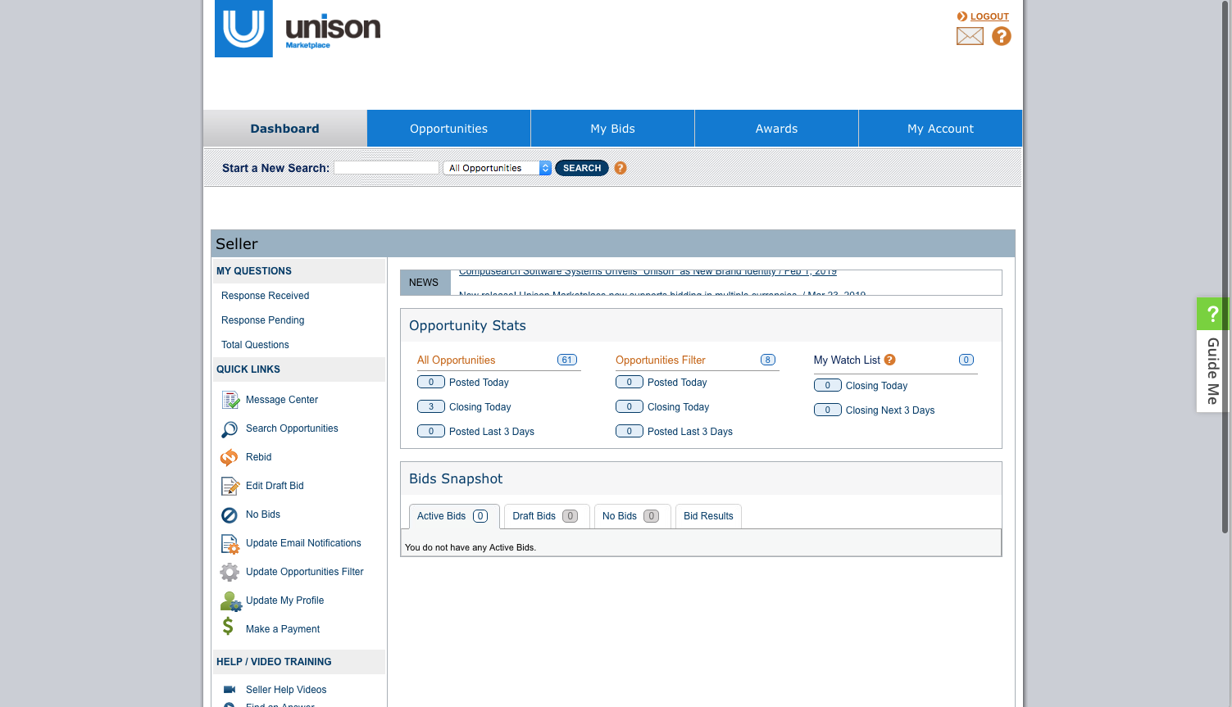
3. To locate a buy, enter the Buy Number in the search bar, and click “search.”

Slide 5
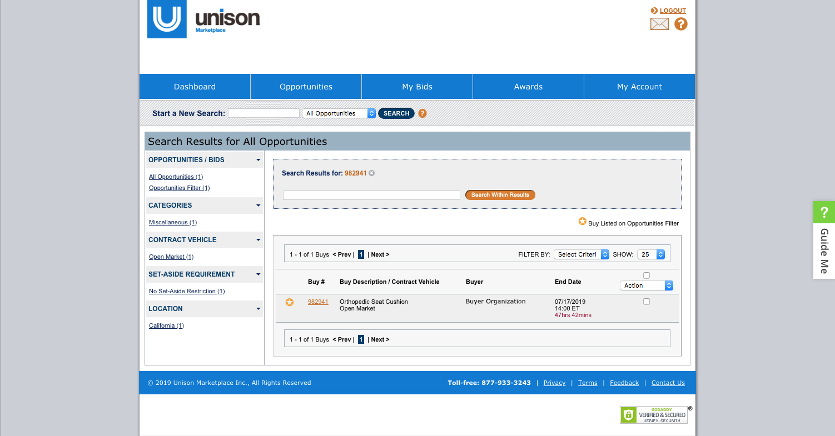
4. Once you have located the buy, click on the Buy Number.

Slide 6
5. This is the buy details page. Here you can view the deadline for bid submission, contract type, set-aside restrictions, delivery requirements, and shipping location.

Slide 7
6. Click “Place Bid” at the bottom of the page to begin placing your bid.

Slide 8
7. This first page is the “Terms” page, which contains the Buy Terms that the Buyer has set.

Slide 9
8. The first two things you need to enter are the “Bid Description” and “Seller Reference Number.”

Slide 10
9. Enter your Contract Vehicle information, if applicable (contract number, contract owner, and contract expiration date).
Note: If the buy is “Open Market” these fields will be grayed out.

Slide 11
10. Fill out the “Delivery Days” field, with the number of days you can guarantee delivery.
Note: Only numbers will be accepted, and the time must be submitted in days. For example, two weeks must be submitted as 14.

Slide 12
11. Check off all boxes on the right side of the page to indicate your bid complies with each of the terms that the Buyer has set.

Slide 13
12. Once all fields are entered and terms checked, continue down the page. If attachments have been included by the Buyer, they will be located here. Then click “Continue.”

Slide 14
13. Take a moment to look at the blue tab labeled “Terms.” A check mark will appear if all fields entered are correct. If a red “!” appears, you have an error on the previous page that needs to be corrected.

Slide 15
14. To add an attachment, please scroll to the bottom of the Seller Attachment(s) section and click “Add Attachment.”

Slide 16
15. Next, fill in the description field. Enter a detailed description of the product or service you are offering.
Note: If this is an exact match buy there will not be a description field.

Slide 17
16. Fill in the “Unit Price” field.
Note: the unit of issue and quantity. The system will multiply your unit price by the quantity listed next to the unit of issue.

Slide 18
17. The “included in line item” feature allows you to include the price of one line item into another. This feature is optional and should be left blank if not being used.

Slide 19
18. “Stop Auto Rebid At” is an optional feature that allows the system to rebid for you while you’re away.
Note: If you prefer to rebid manually, leave this box blank. If using this feature, please indicate your floor price in the “Stop Auto Rebid At” box.

Slide 20
19. Be sure that you have entered a description and a price for all line items.
Note: If you have used the “included in line item” feature, leave the unit price field blank for that item.

Slide 21
21. Take a moment to look for the check marks next to both the “Terms” and “Line Items” sections at the top of the page.
Note: If there is a red “!” on either or both tabs, please navigate back to those pages to correct any errors.

Slide 22
22. Review your all bid information to ensure it is correct and that you can comply with all terms.
Note: Navigate back to edit any incorrect information. All bids submitted on Unison Marketplace are legally binding offers. You may print this page for your records.

Slide 23
23. Here you can see a breakdown of your pricing, including the Unison fee. Ensure your final bid price is correct.
Note: The unit price you have entered is multiplied by the unit of issue.

Slide 24
24. If all the information is correct, click “Submit Bid.”
Note: If you see any red “!” exclamation marks on this page, navigate using the “Back” button to fix any errors.

Slide 25
Congratulations, your bid has been submitted to the Buyer!

